Slide 1
Chapter 1 – Introduction
2025-2026

Slide 2
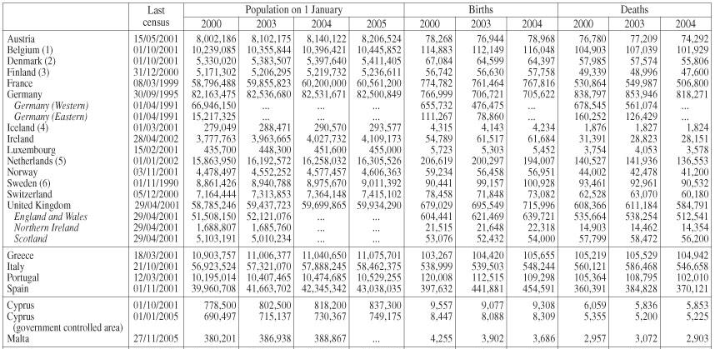
What is data?
Notes:
If you think about Data, you think about Excel sheets. Big tables with a bunch of measurements, numbers, amounts, dates, categories. Tabular data

Slide 3
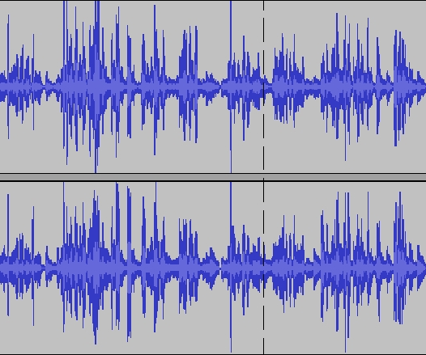

What is data?

Slide 4


What is data?

Slide 5
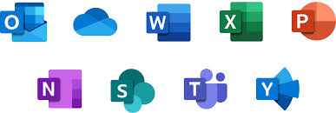
What is data?

Slide 6
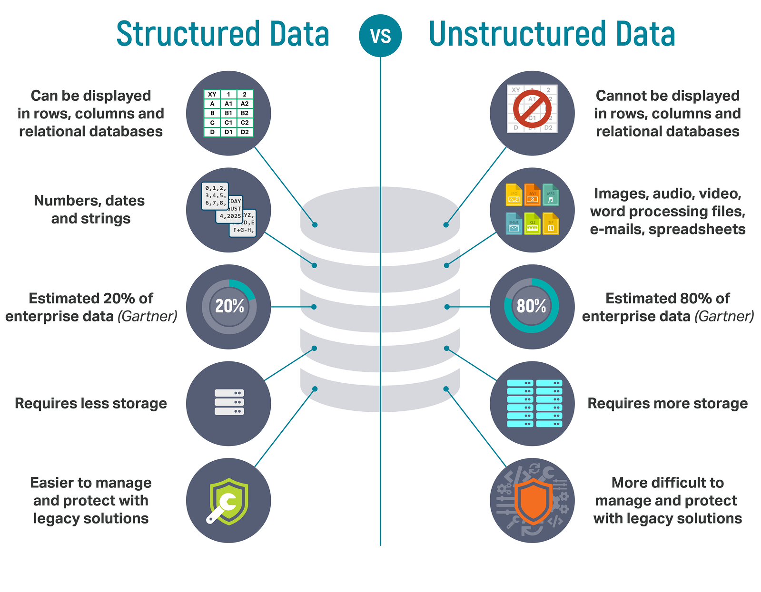

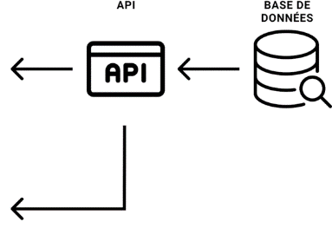
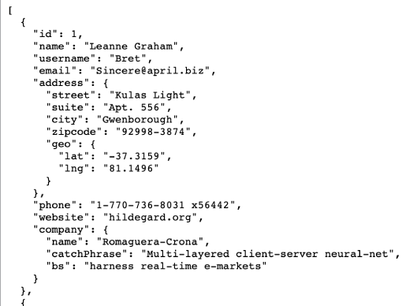
What is data?
Focus in this course
AI track

Slide 7
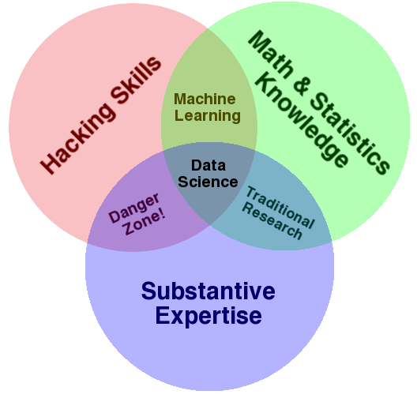
What is data science?
Data science combines math and statistics, specialized programming skills with specific subject matter expertise to uncover actionable insights hidden in an organization’s data. (Definition IBM)
Notes:
Data science combines math and statistics, specialized programming with specific subject matter expertise to uncover actionable insights hidden in an organization’s data
In this course, we will do data science to analyze structured data, data in tables, but data science can also be used to understand unstructured data like images, audio sounds, and text documents.
To do data science properly, you need three things:
hacking skills, or coding skills, so you can write programs that import and analyze data
math and statistics knowledge, so that you use the correct methods to analyze the data and draw conclusions.
substantive expertise, or basically domain knowledge: you need to know what kind of data you’re dealing with and be able to reason about this data.
Data science is at the intersection of three skills.

Slide 8
Buzzword Bingo: AI – ML – DL
AI - Artificial intelligence: techniques to mimic human intelligence.
ML - Machine learning: subset of AI to have machines doing a specific task better and better by gaining experience.
DL - Deep learning: subset of ML that uses artificial neural networks with many layers.
First step to do AI/ML/DL well is data science. You need to understand your data.
AI
AI Essentials class in 2nd term
ML
Specialisation Machine learning in 3rd year
Specialisation Machine learning in 3rd year
DL
Data Science
Notes:
Let’s have a look at how these different buzzwords map to the different classes you’ll have.
In the AI essentials class, you’ll get a general intro into AI, recursion, graph search, games, logic program, you’ll do some classical machine learning, and also some deep learning.
In the specialisation track Machine Learning you learn some ML techniques like linear regression, decision trees, SVMs, etc. and you get a deep dive and you’ll take a deeper dive into Deep Learning.
In the Data Science class, this one, you’ll use the techniques to understand your data, which is a necessary first step before you can do anything fancy.

Slide 9
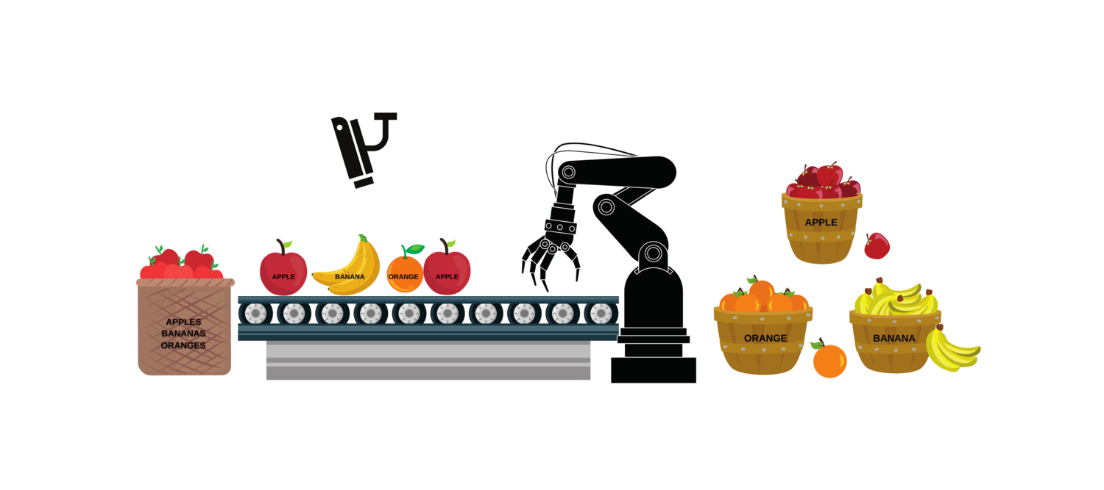
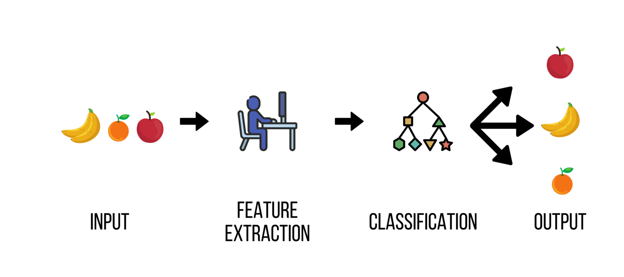
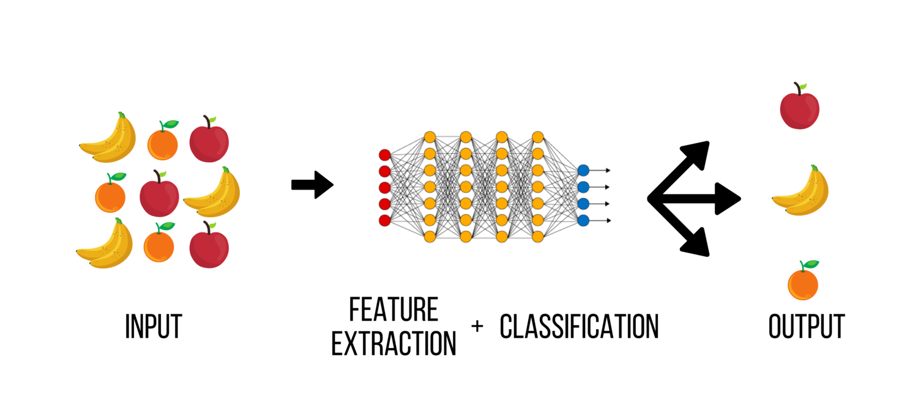
Buzzword Bingo: AI – ML – DL
Notes:
https://www.advancinganalytics.co.uk/blog/2021/12/15/understanding-the-difference-between-ai-ml-and-dl-using-an-incredibly-simple-example
François Chollet, creator of Keras, described AI as “the effort to automate intellectual tasks normally performed by humans”.
ML is the field of study that gives computers the ability to learn without being explicitly programmed (supervised /unsupervised learning)
As shown in the diagram, ML is a subset of AI which means all ML algorithms are classified as being part of AI. However, it doesn’t work the other way and it is important to note that not all AI based algorithms are ML. This is analogous to how a square is a rectangle but not every rectangle is a square.
DL is ML taken to the next level. It is a subset of ML that is inspired by how human brains work. Typically, when people use the term deep learning, they refer to deep artificial neural networks. DL effectively teaches computers to do what humans naturally do: learning by example.
AI:The success of the AI-based system hinges upon the fruit being correctly labelled by the fruit pickers and having a scanning system in place that can inform the algorithm of what the fruit is. Here, Mark utilises an AI-based system to automate intellectual tasks generally performed by humans. As this system is based upon a rule-based engine that has been hard coded by humans, it is an example of AI without ML.
ML: An ML-based algorithm is now proposed to solve the problem of fruit sorting by enhancing the AI-based approach when labels are not present.
To create a ML model, a definition of what each fruit looks like is required: this is termed feature extraction. To do this, features and attributes that characterise each fruit are used to create a blueprint. Features such as sizes, colours, shapes, etc., are extracted and used to train the algorithm to classify the fruits accordingly.
DL:A DL-based algorithm is now proposed to solve the problem of sorting any fruit by totally removing the need for defining what each fruit looks like.
The main advantage of the DL model is that it does not necessarily need to be provided with features to classify the fruits correctly.
By providing the DL model with lots of images of the fruits, it will build up a pattern of what each fruit looks like. The images will be processed through different layers of neural network within the DL model. Then each network layer will define specific features of the images, like the shape of the fruits, size of the fruits, colour of the fruits, etc. A DL based model, however, comes at a considerable upfront cost of requiring significant computational power and vast amounts of data.

Slide 10


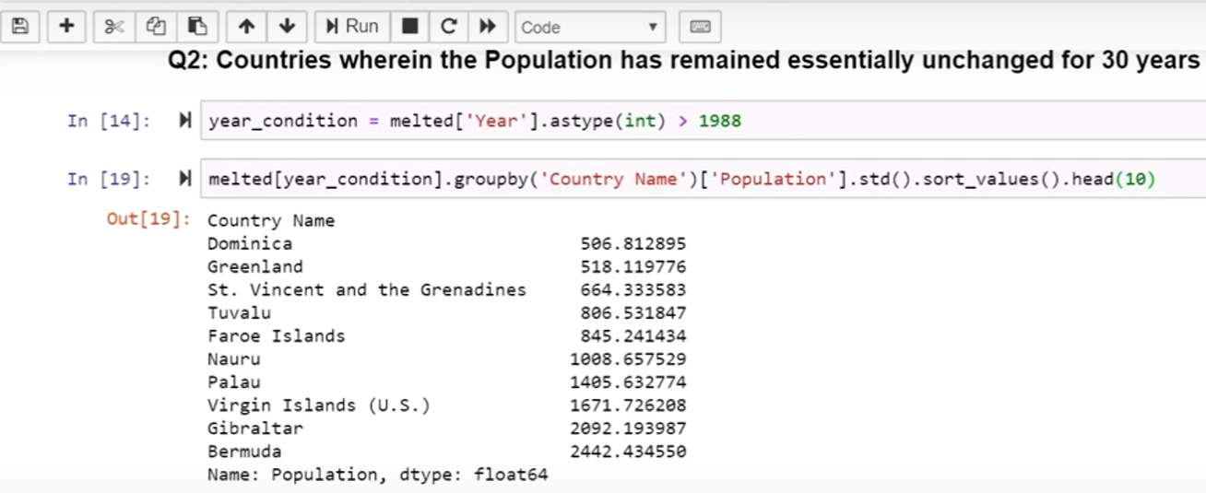
Data science or machine learning?
Notes:
Data Science on structured data

Slide 11
Data science or machine learning?
By doing data manipulations, you can build animated visualisations
Data visualisation is a separate course in the 2nd term.
Notes:
Data Science on structured data
In classical data science, you start from data in a tabular format, with rows and columns. By doing some manipulations on this data, you could build animated visualizations. The result is a compelling plot that shows clearly that as time went on, GDP per capita went up, and life expectancy went up as well. Much better than the boring data we started with in the beginning, and much easier for humans to reason about.
How to visualize data in a correct way is the topic of a separate course in the 2nd term.
This graph: Hans Rosling:, https://www.youtube.com/watch?v=hVimVzgtD6w

Slide 12












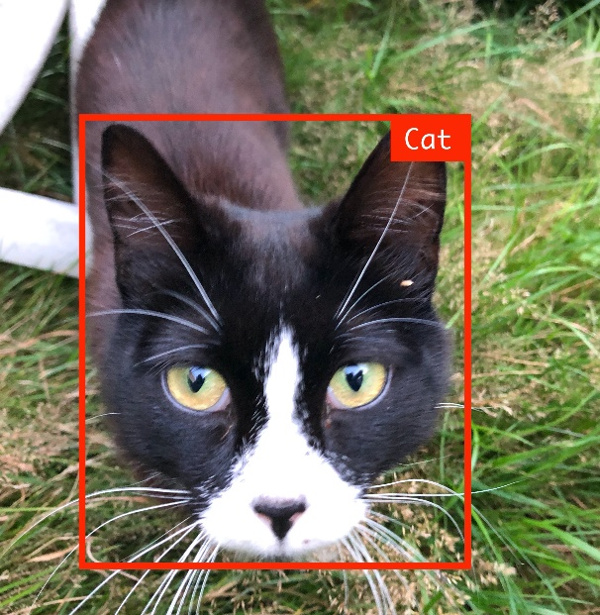
Data science or machine learning?
MODEL
Notes:
This is machine learning. You could use deep learning for this task, but you don’t have to.

Slide 13
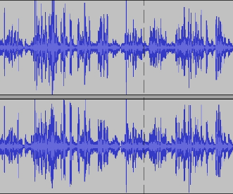
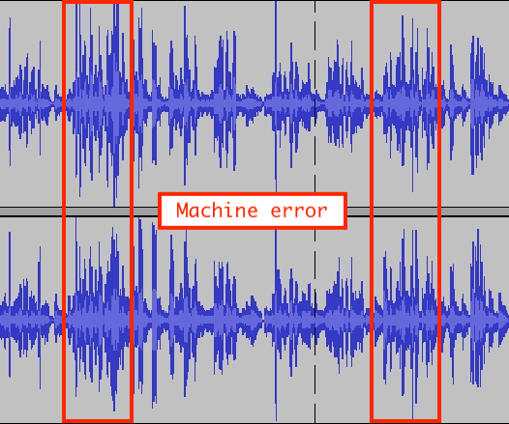
Data science or machine learning?
MODEL
Notes:
This is machine learning. You could use deep learning for this task, but you don’t have to.

Slide 14
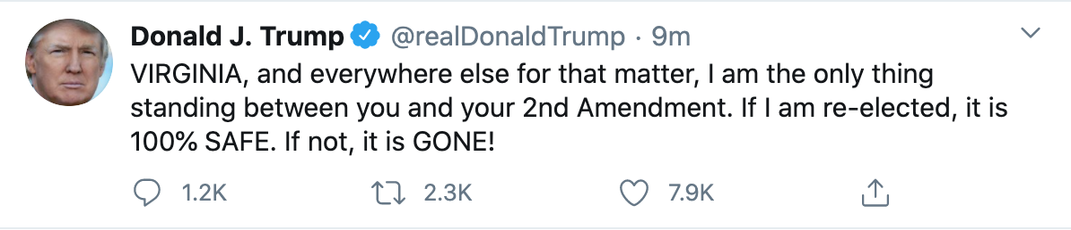
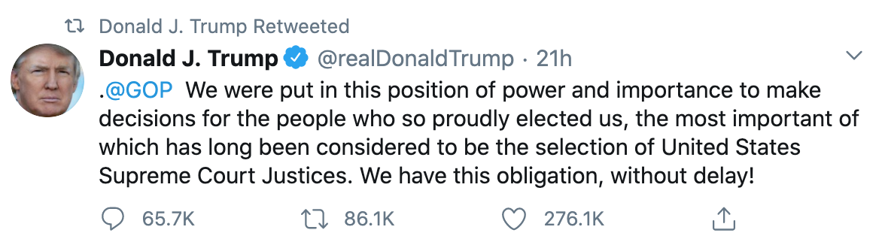


Data science or machine learning?
“Trump’s tweets in 2020 contain on average 270.4 characters.”
“Trump’s tweets in 2020 contain on average 2.4 words that are unnecessarily capitalized”
Notes:
Data Science on unstructured data. In this course we focus on structured data.

Slide 15
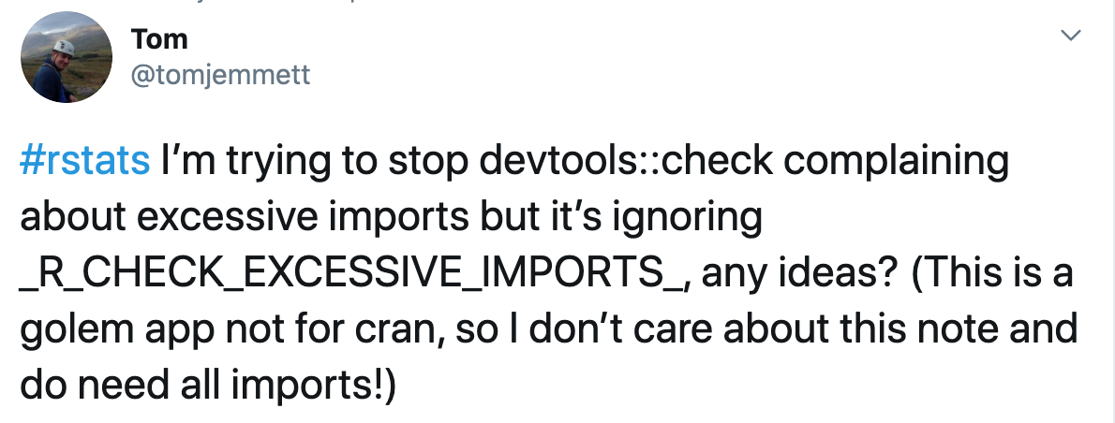
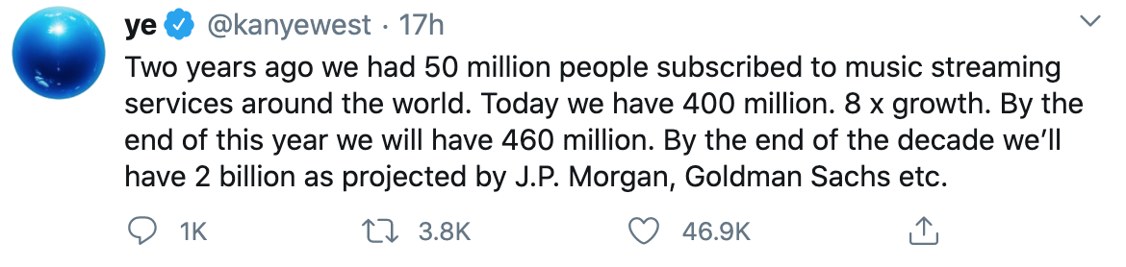
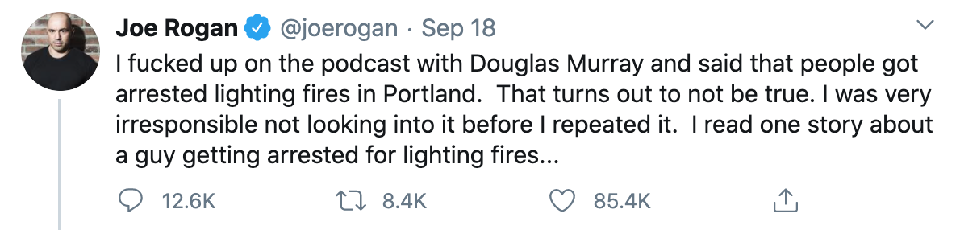

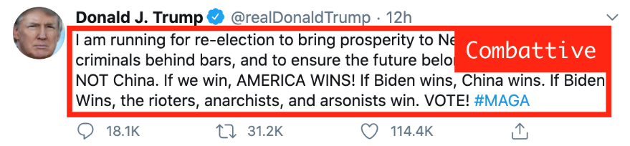
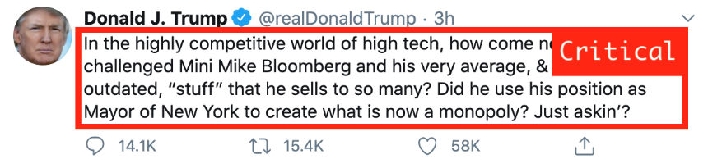
Data science or machine learning?
MODEL
Notes:
You could also do machine learning with these tweets: based on loads of tweets, you could for example build a model that does a sentiment analysis on a tweet, telling whether the tweet was aggressive, friendly, combattive, questioning, etc.
This is classical machine learning, and there are also deep learning approaches for these kinds of tasks.

Slide 16
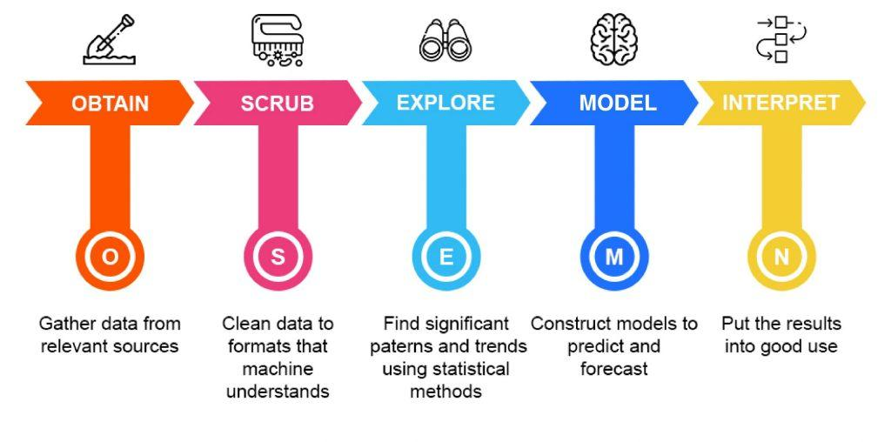
The data science process
The data science life cycle involves various roles, tools, and processes, which enables analysts to gain actionable insights. Typically, a data science project undergoes the following stages:
Notes:
https://thelead.io/data-science/5-steps-to-a-data-science-project-lifecycle

Slide 17

Step 1: Obtain
Query databases
Scrape websites
Read Excel-files
Call API’s
Read CSV’s
…
Get and combine the data from anywhere you can
But: only use properly governed data
More is not better when more means less reliable

Slide 18

Step 2: Scrub
= Data wrangling
Are all dates recognized as dates?
Are all numbers recognized as numbers?
Is the information of different files correctly merged?
Does every datapoint translate to a single piece of information?
National Insurance Number: date of birth and gender
Street name and number: Split? Merge?
Are there missing values? How will you deal with them?

Slide 19

Step 3: Explore
= EDA (Explorative data analysis)
Try to make sense of all available data
Create some graphs, examine the distribution of all variables
Are there correlations between the data? Should there be?
High blood pressure in relation to height and weight
Do not assume causation!
If needed, go back to “Scrub”
Identify and label categorical data
Merge or split datapoints
Deal with outliers
Also: talk to the domain experts

Slide 20

Step 4: Model data
Create models that can explain or predict based upon the data you have imported
Classify using logistic regression
Predict using linear regression
Cluster using k-means or hierarchical clustering
We don’t cover this step in this course.

Slide 21

Step 5: Interpret the data
The ultimate goal of every data science-project
Test how the models we made generalize
Explain our findings to a non-domain specialist
Answer the questions we posed in the beginning
Do heavier cars always consume more gas?
In which season are there more insect-bites?
Tell a story using the data you were given.

Slide 22
Summing up
OSEMN | Description | Technologies used
Obtain | Gathering data from databases, the web, open data platforms like Kaggle, … | SQL, Web APIs, Web Scraping via Python libraries like Beautiful Soup, …
Scrub | Organising and tidying up the data, removing what is no longer needed, replacing what is missing and standardising the format across all the data collected. | Regex, Python Pandas library
Explore | Inspecting and analyzing the data with descriptive statistics (min-max-mean-median-correlations-distributions-…) and basic visualisations. | Python libraries like NumPy & Pandas Visualisation libraries like MatPlotLib & Seaborn Visualisation tools like Qlik, Tableau, PowerBI
Model | Setting up models to forecast future values or classify and group values. | Python libraries like SciKit
Interpret | Presenting the data to an audience. Delivering the results in such a way business questions are responded, and actionable insights are provided. | Python libraries like Matplotlib & Seaborn Javascript libraries like d3js Dashboarding tools like Qlik, Tableau, PowerBI
Notes:
Explore is for developers (for you), interpret is for the end user (aka the storytelling).
Explore: intermediate sheets
Interpret: create the dashboards

Slide 23
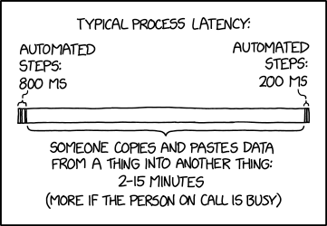
What we want to avoid
Notes:
https://xkcd.com/2565/
We’re going for a full automation of the data-processing pipeline…

Slide 24
Which language?
R
Statistical language, preferred by researchers and mathematicians
Originally the first and only language to do data science in
Python
General purpose programming language, preferred by computer scientists
Evolved into a perfect alternative to R
Julia
Programming language made for data science
Fixes problems that you have with Python when dealing with ginormous amounts of data
Notes:
We chose Python because you have a basic knowledge in that language, which gives us something to build on.

Slide 25
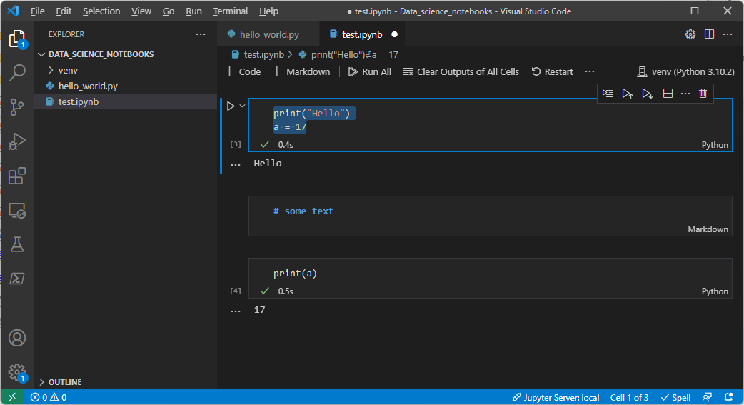
Which IDE?
VSCode and Jupyter notebooks
See separate presentation for installation and setup

